Slide 1
Youth and Alcohol at Community Events
Community Readiness Assessment
Kathryn Crombie, MScGH
Health Promotion Specialist
Clatsop County Department of Public Health

Slide 2
Clatsop County Department of Public Health—Alcohol and Drug Education and Prevention Program (ADPEP)
National University of Natural Medicine—Masters of Science in Global Health Program
Oregon Health and Science University (OHSU)
Notes:
This was a project done in collaboration with the Clatsop County Alcohol and Drug Education Program, the National University of Natural Medicine, and OHSU

Slide 3
Community Readiness Assessment
Fall 2020
Level of readiness in Clatsop County to address youth exposure to alcohol at community events
One step in larger assessment process
Goal of ADPEP: Reduce youth alcohol use in Clatsop
Notes:
In fall of 2020, an assessment was conducted to determine the level of readiness in Clatsop County to address youth’s exposure to alcohol at community events
This process was just one step in larger assessment process we have planned to inform the strategies to reduce youth alcohol use in Clatsop County

Slide 4
Community Readiness Model (CRM)
Community-directed, theory-driven approach to identify level of knowledge and motivation for social change
Purpose of the CRM is to provide communities with the stage of readiness for the development of appropriate strategies that are more successful and cost effective
6 dimensions of a community and 9 stages of readiness
Each stage of readiness has specific interventions that work most effectively for that stage
Notes:
We used the Community Readiness Model which is a community-directed, theory-driven approach to identifying the level of knowledge and motivation for change in communities.
It’s purpose is to provide communities with a determined level of readiness to then develop appropriate strategies that are more successful and cost effective
The assessment includes 6 defined dimensions of a community and 9 stages of readiness
Each stage of readiness has specific interventions that work most effectively for that stage

Slide 5
6 key dimensions
9 stages of readiness
A. Prevention Programming
B. Community Knowledge of Prevention efforts
C. Leadership
D. Community Climate
E. Knowledge of the Issue
F. Resources for prevention efforts
Notes:
The 6 key dimensions in a community that include prevention programming, community knowledge of efforts, leadership, community climate, community knowledge of the issue, and resources.
The 9 stages of readiness they are: no awareness, denial/resistance, vague awareness, preplanning, preparation, initiation, stabilization, confirmation/expansion, high level of community ownership
A level of readiness from 1-9 is assigned to each dimension. The strategies developed relies on these community readiness scores.

Slide 6
Key informant interviews
Requested 10; 7 were conducted from individuals representing the following sectors:
Law Enforcement
Juvenile Justice
Health and medical professional
Social service organization
Event organizer
Alcohol retailer
Person in recovery from alcoholism
36 open ended and scaled questions covering the 6 dimensions
Chosen through process guided by health department staff
Notes:
The main component of this readiness assessment is the key information interviews. We requested 10 interviews, we were able to conduct 7 interviews representing law enforcement, juvenile justice, medical field, social service, event organizer, alcohol retailer, and a person in recovery from alcoholism
Each interview consisted of 36 open ended and scaled questions covering the 6 dimensions.
They were chosen through a process guided by the health department staff. The staff were asked to name a community member in each sector and indicate why they think they would be a good person to represent that sector. They were asked to “think outside the box” and choose people representative of all parts of the county.
Interviews included individuals from sectors including law enforcement, juvenile justice, health and medical profession, social service organization, event organizer, alcohol retailer, and a person in recovery from alcoholism

Slide 7
Community Findings by Dimension
Dimension A: Prevention Programming
Score: 3—Vague awareness
A few individuals recognize local concern or need to initiate some type of effort, but not immediate motivation to do anything
Knowledge of some existing efforts
Oregon Liquor Control Commission (OLCC) regulations named as the main efforts aimed at this issue
Notes:
Each dimension receives a score. The first one is Dimension A: Prevention programming and it was found to have a score of 3 which is vague awareness.
It was found that there are some knowledge of existing efforts, but the Oregon Liquor Control Commission (OLCC) regulations named as the main efforts aimed at this issue.

Slide 8
Community Findings by Dimension
Dimension B: Community Knowledge about Prevention
Score: 2—Denial/Resistance
Some community members recognize a concern, but there is little recognition that it might be occurring locally
Knowledge something should be but, nothing specific mentioned
Focus on OLCC regulations adequate for prevention
Notes:
Dimension B: Community knowledge about prevention received a score of 2 which is denial or resistance.
This means that some community members recognize that this is a concern, but don’t fully recognize that it might be occurring locally
The focus was again on OLCC regulation and the thought that they should be adequate for prevention

Slide 9
Community Findings by Dimension
Dimension C: Leadership
Score: 2—Denial/Resistance
Leadership believes alcohol at community events where youth are present is not a concern in their community
No recognition of anything happening to address from leadership
Notes:
Dimension C: Leadership had a score of 2:denial or resistance.
This means that some community members recognize that this is a concern, but don’t fully recognize that it might be occurring locally
Little to no recognition of anything happening to address this from leadership

Slide 10
Community Findings by Dimension
Dimension D: Community Climate
Score: 2—Denial/Resistance
The prevailing attitude is “there’s nothing we can do,” or “only ‘those’ people do that.”
Influence alcohol may have was not a big consideration; setting an example was not a main point of discussion
Resistance to prohibition of alcohol at community events and responsibility is put on OLCC regulation ; these were thought to be enough to keep alcohol out of the hands of youth
Attitude that youth are going to drink alcohol either way, and it can’t be prevented so the regulations are adequate
Notes:
Dimension D: Community Climate was found to have a score of 2—denial/resistance.
The prevailing attitude was there’s nothing we can do. The influence that alcohol may have in our culture was not a big consideration
The idea that OLCC regulations should be good enough to prevent youth alcohol use was apparent in this dimension as well
There was a resistance to prohibition of alcohol at community events and the idea that youth are going to drink alcohol either way

Slide 11
Community Findings by Dimension
Dimension E: Community Knowledge of Issue
Score: 3—Vague awareness
A few community members have basic knowledge of youth exposure to alcohol at community events, and recognize some people may be affected by youth exposure to alcohol at community events
Awareness about alcohol consumption, but less knowledge about community norms and their impact
Notes:
Dimension E: Community Knowledge of the issue had a score of 3—vague awareness .
This means a few community members have basic knowledge of youth exposure to alcohol at community events and recognize that some people may be impacted by it
There was greater awareness about alcohol consumption and use, but community norms and the impact they have on alcohol use was less known

Slide 12
Community Findings by Dimension
Dimension F: Resources for Prevention Efforts
Score: 3—Vague awareness
Community not sure what it would take (or where resources would come from) to initiate efforts
No knowledge except for OLCC regulations and flyers mentioned
Focus on prevention to alcohol service via parent responsibility, education, and OLCC rather than youth perception and community norms
Notes:
Finally, Dimension F: Resources for Prevention Efforts had a score of 3—vague awareness
This means the community is not sure what it would take or what resources would be needed to initiate efforts
No knowledge of resources except for mention of OLCC and flyers
There was a focus on prevention to alcohol service through parent responsibility, education, and OLCC regulation and none regarding youth perception and community norms

Slide 13
FINAL RESULTS
OVERALL TOTAL: 2—Denial/Resistance
Some community members recognize that this is a general concern, but little knowledge of this issue occurring locally
Some key informant concerns
Importance of role modeling
Education
Alcohol served at community events necessary for financial benefit
Prohibition would be an overstepping of the government
Not a priority, public health should be focused on homelessness and opioid addition
Notes:
Clatsop County’s overall level of readiness to address alcohol at community events where youth are present was a 2: denial and resistance
This means that some community members recognize that this is a general concern, but little knowledge of this issue occurring locally
Some of the key informant concerns mentioned included role modeling and education as more important measures to reducing youth alcohol use.
Some mentioned that alcohol served at community events was necessary for financial benefit and that prohibiting this would be an overstep of the government
And that this should not be a priority and public health should be focused on things like homelessness and opioid addiction

Slide 14
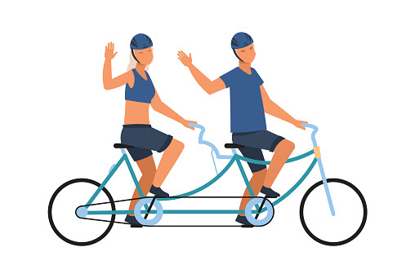
Why is this important to reducing youth alcohol use?
Social Norms
Expected behaviors in society
They may be true or false
Provide us with an expected idea of how to behave, and function to provide order and predictability in society.
Notes:
Why is this important to reducing youth alcohol use?
Social norms are expected behaviors in society, they can be true or false, but they can have a lot of influence in how people behave in a community. Because of this, they can greatly influence the health in the community.
I like to use the example of biking to work. If someone moves to a new city and see a lot of people ride a bike to work most people want to fit into society and this person perceives that biking to work is the right thing to do, so odds are they are likely going to start biking to work too
Social norms are not always healthy like riding your bike to work. When alcohol is a community norm, reflected in such ways like having alcohol at community events, this can negatively impact health outcomes in that community.

Slide 15
Alcohol Use
95,000 deaths are attributed to excessive alcohol use each year
Short term health impacts:
Long term health impacts:
Injuries
Violence, including suicide
Alcohol Poisoning
Risky behaviors
Adverse pregnancy sexual and fetal outcomes
High blood pressure
Heart disease
Stroke
Liver disease and digestive problems
Cancer of the breast, mouth, throat, esophagus, liver, and colon
Learning and memory problems including dementia
Social problems
Alcohol dependency or alcoholism
Notes:
Excessive alcohol use is a significant public health issue
95,000 deaths attributed to excessive alcohol use each year.-- 3rd leading cause of preventable deaths in the United States
There are many short and long term health impacts from alcohol use

Slide 16
Underage Drinking
3,500 deaths and 210,000 years of potential life lost each year
Associated with development of an alcohol use disorder later in life
Youth who drink alcohol more likely to experience:
School, social, legal, and physical problems
Unwanted, unplanned or unprotected sexual activity
Disruption of normal growth or sexual development
Physical and sexual violence
Increase risk of suicide and homicide
Alcohol-related motor vehicle crashed and unintentional injuries
Memory problems
Misuse of other substances
Changes in brain development that may have life-long effects
Alcohol poisoning
Notes:
Excessive drinking among people under age 21 years old is responsible for over 3,500 deaths
Youth early initiation of drinking alcohol is associated with development of substance misuse later in life, alcohol use disorder later in life, experience school, social, legal, and physical problems, memory problems, and changes in brain development to name a few.

Slide 17
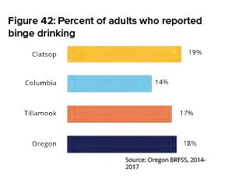
Clatsop County Alcohol Use
19% of adults report binge drinking
3% of deaths alcohol-induced including liver disease (not including overdose and poisoning)
Notes:
In Clatsop County, 19% of adults reported binge drinking
3% of deaths in Clatsop County were alcohol-induced

Slide 18
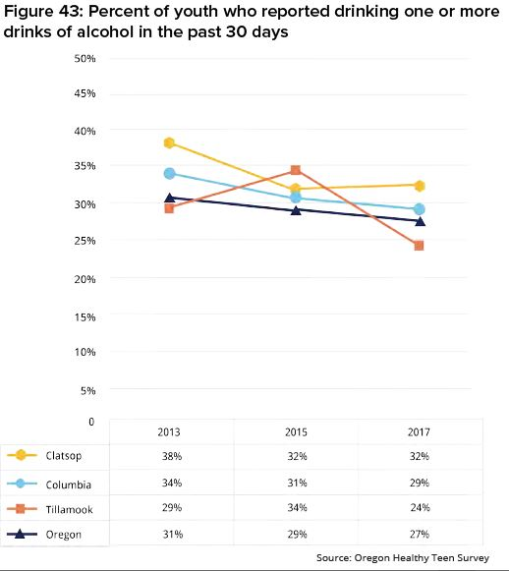
Clatsop County Alcohol Use
32% of youth reported drinking one or more drinks of alcohol in the past 30 days; Compared to Oregon 27%
Notes:
In Clatsop County, 32% of youth reported drinking one or more drinks of alcohol in the past 30 days. This was higher than Oregon as a whole which was 27% of youth

Slide 19
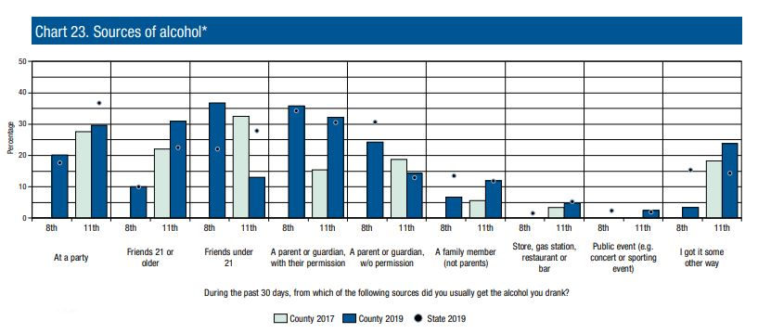
Clatsop County Alcohol Use
Notes:
The most common source of alcohol reported by youth was from a parent or guardian with their permission (35.8% of 8th graders and 32.2% of 11th graders)

Slide 20
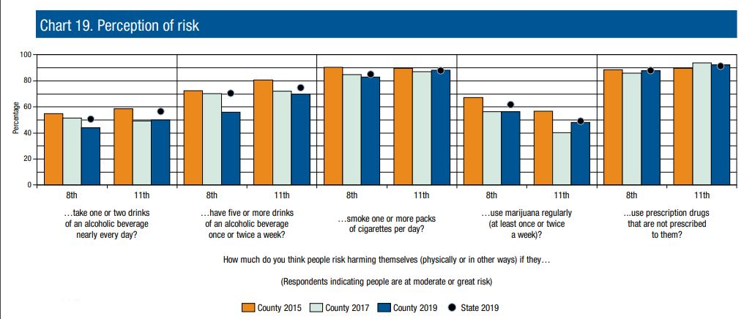
Clatsop County Alcohol Use
Notes:
When asked about the risk of one or two drinks every day and five or more drinks once or twice a week, both 8th and 11th graders had significantly lower perceptions of risk than that of the state average.

Slide 21
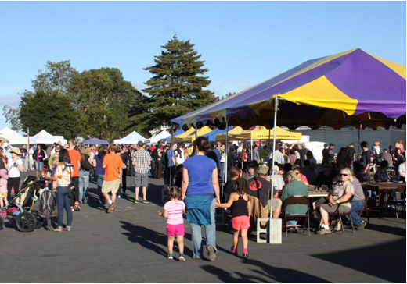
Why Community events?
Clatsop County holds approx. 50 community events that serve alcohol annually
Many advertised as family friendly like the two shown below
Community Protective Factors related to alcohol misuse:
• Access to support services
• Community norms against alcohol use
• Healthy leisure activities
• Opportunities for meaningful youth engagement
• Exposure to evidence-based programs and strategies
• Local and state policies that support health norms
• Safe, supportive, connected neighborhood
Notes:
Community events reflect the values of the community and in turn become the social norm. Promoting community norms that are against alcohol use is a protective factor related to alcohol misuse, especially for youth.
According to the Chambers of the five cities, Clatsop County hosts 50 community events annually that serve alcohol. Many are advertised as family friendly events

Slide 22
What’s next?
Still working on assessment and next steps part of the CRM process
Develop strategies/conduct workshops: Next steps
Evaluate strategy effectiveness: Next steps
Approaches focused on community events, changing policies and practices to prevent youth access.
Not focused on prohibition; focus on changing the context of drinking alcohol in the community
Notes:
Further assessment of the local environment will be conducted to get an idea of the effectiveness of practices.
Some of the approaches should be focused on community events and changing policies and practices to prevent youth access.

Slide 23
Questions?
Kathryn Crombie
Clatsop County Department of Public Health
Health Promotion Specialist
503-440-5563
kcrombie@co.clatsop.or.us

Slide 24
Sources
McLeod, S. A. (2008). Social Roles. Simply Psychology. https://www.simplypsychology.org/social-roles.html
CDC. (2020, October 1). Alcohol Use and Your Health. https://www.cdc.gov/alcohol/fact-sheets/alcohol-use.htm
Costello, H., Nelson, N., Henry, K., & Freedman, K. (2012). Catalog of Environmental Prevention Strategies. 147.
Ng, E., & Colombani, P. (2015). Framework for Selecting Best Practices in Public Health: A Systematic Literature Review. Journal of Public Health Research, 4(3). https://doi.org/10.4081/jphr.2015.577
Substance Abuse and Mental Health Services Administration. (n.d.). Risk and Protective Factors. https://www.samhsa.gov/sites/default/files/20190718-samhsa-risk-protective-factors.pdf
Clatsop County Labor Force and Industry Employment. (2020). State of Oregon Employment Department.

