Slide 1
Cultural Humility

Slide 2
Culture
Culture - “the customs, arts, social institutions, and achievements of a particular nation, people or other social group”
Culture weighs heavily in people’s thoughts, habits, and beliefs that they will hold for the rest of their lives.

Slide 3
Cultural Competency
Been around as a concept for about fifty years now
Is loosely defined as the ability to understand, appreciate, and interact with people from cultures or belief systems different from one’s own

Slide 4
Cultural Humility
Coined by Melanie Tervalon and Jann Murray-Garcia in 1998
Rather than learning about other cultures, cultural humility looks to instill a mindset of self reflexion, humility, and lifelong growth.

Slide 5
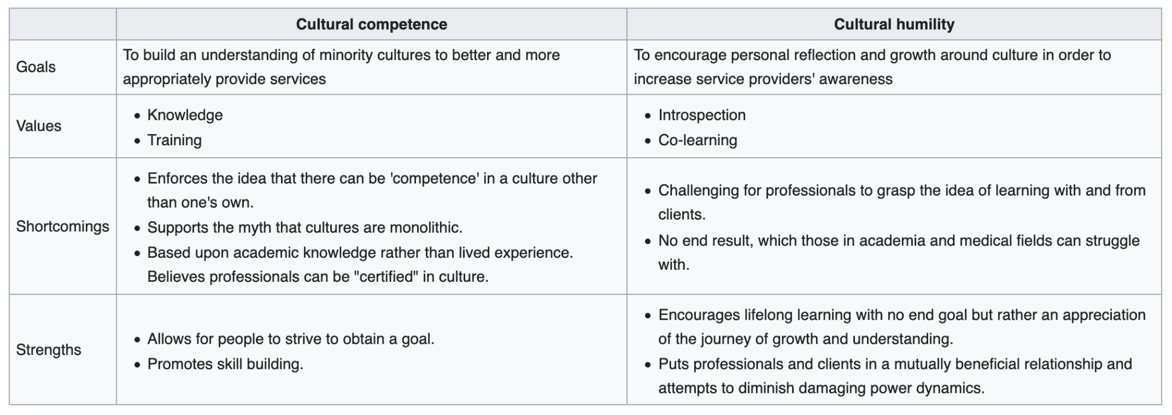

Slide 6
Why might Cultural Competency be problematic?

Slide 7
Cultural Competency can be problematic because
It can inadvertently promote othering
People have so many identities and intersections between those
It implies you can be all-knowing
Can be self-defeating- sticking to what you were told as opposed to what you hear from individuals or situations
Where is that academic knowledge being sourced from?

Slide 8
Keys to Cultural Humility
Recognize no culture is better than another (duh)
Engage in self reflection
Be honest when you’re not sure about something
Learn about other cultures with the awareness you’ll never reach perfect understanding (sympathize as opposed to empathize)

Slide 9
Keys to Cultural Humility
Be aware of power dynamic present in service provider-client relationship
Ask people in your life if you can have open discussions and if you can be held accountable over your learning journey
Be humble if people are either rude or don’t make your journey feel rewarding/appreciated
Live with being wrong (or being right)

Slide 10
How to respond if corrected
You’re probably not the first person to make this mistake - what will determine whether or not it ends up being water under the bridge is how you respond
DON’T be defensive - take a moment, collect your thoughts. Ask yourself where this person is coming from
Apologize OR say “thank you” - your being taught
If you apologize, don’t flagellate yourself

