Slide 1
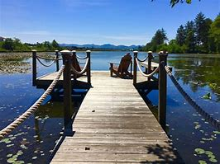
Clatsop County REPRODUCTIVE Health

Slide 2
The Oregon Reproductive Health(RH) Program works with over 100 clinics across the state to offer free or low-cost reproductive health services and birth control.
Funding s available to cover services for low-income people wo can get pregnant or get someone else pregnant, regardless of immigration status, sex or gender identity.
All services are voluntary and confidential and include:
Birth control and condoms
Women’s check ups, including breast exams and pap tests
Emergency contraception
Pregnancy tests
Screening for sexually transmitted diseases
Vasectomy referrals
Available options:
Oral contraception
Depo-provera injection
Nuvarings
IUD/IUS
Patches
Nexplanon Implants

Slide 3
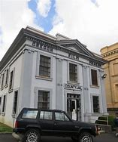
COMMUNITY PARTNERS

Slide 4
Program Element 46 (PE46)
Community Participation and Assurance of Access to Reproductive Health Services
The focus is to assure access to clinical RH services throughout the state. LPHAs are expected to work with community partners to identify gaps and barriers to service, and develop and implement plans to enhance access, especially for those most marginalized. The goals align with public health modernization.
We have asked our patients to complete surveys in the past covering such topics as:
Hours they would like to see us open
Transportation concerns
Contact preferences
Through our Quality Improvement (QI) Team we determined:
Across the board responses are consistent with extending our hours and making contact through text. Changes were made and over a 6 month period our No show rates actually increased which is not fiscally sustainable for our program.
We would like a broader approach to reach community members who are not existing patients to educate them on our services as well as identifying the PE46 goals above.

Slide 5
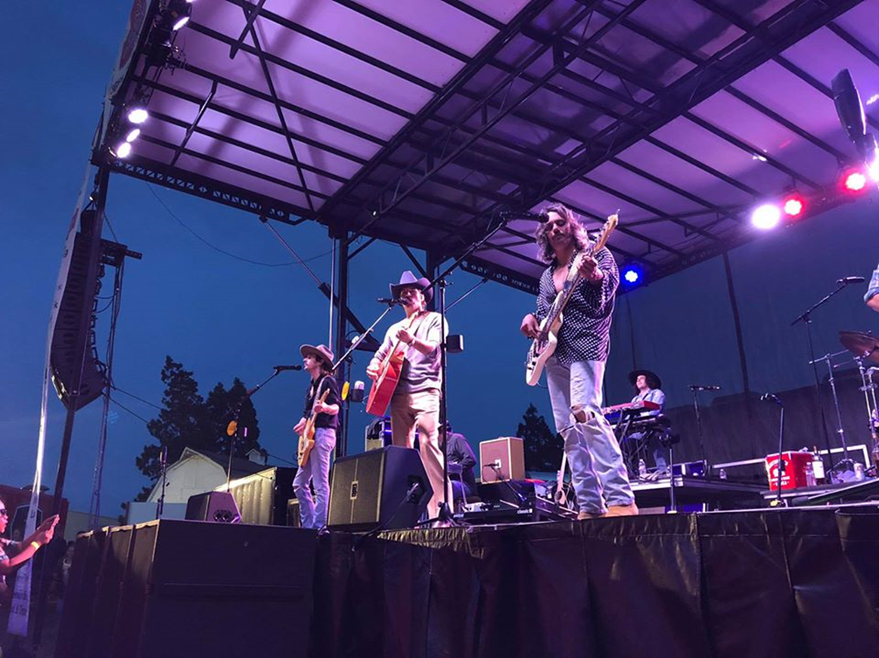
Astoria regatta Midland concert Clatsop county fair

