Slide 1
Partnering with Communities on Suicide Prevention Efforts
Teresa Lavagnino, Community Engagement Specialist (Columbia County)
Nancy Knopf, Director of Community Partnerships

Slide 2
Objectives
Understand the context, history and next steps for Columbia Pacific’s support of suicide prevention work in our communities
Provide us with feedback and generate ideas for partnerships around suicide prevention work locally
Notes:
Teresa

Slide 3
The Importance of Suicide Prevention
5-year Suicide Death Rate per 100,00 (age-adjusted, 2015-2019)
Columbia | Columbia | Tillamook | Oregon*
24 | 22 | 22 | 19
*Ranked 9th nationally out of all states for rates of deaths by suicide in 2019
Total Deaths from Suicide
 | Clatsop | Columbia | Tillamook | Oregon
2017 | 9 | 9 | 6 | 825
2018 | 9 | 17 | 5 | 844
2019 | 8 | 9 | 4 | 908
Years of Potential Life Lost (before age 75)
 | Clatsop | Columbia | Tillamook
2017 | 195 | 288 | 302
2018 | 219 | 219 | 78
2019 | 231 | 208 | 34
Notes:
T
It’s really difficult to capture this data accurately on an annual basis because of different recording mechanisms, how the medical examiner classifies it, etc.; Also a reason why we don’t have 2020

Slide 4
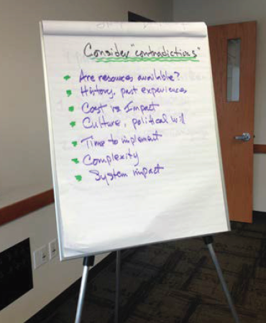
History of community partnership around suicide prevention
Community need identified in first CHA/CHP
Community advisory councils sponsored suicide prevention activities in the region
String of youth suicides in Columbia County led to more community collaboration and the start of a suicide prevention task force
Notes:
Teresa
Large grant in the 3rd year in Columbia County, this is how we got to that

Slide 5
Next steps in suicide prevention
Priority area of Regional Health Improvement Plan (RHIP)
RHIP deliverables: increased awareness and prevention programming in every county
Specific investment ask and investment strategy (in development)
Promote collaboration at every level
Notes:
Nancy

Slide 6
Next steps in suicide prevention- Investing in Region
Training of trainers in suicide prevention Evidence Based Practice ASIST, QPR, MHFA, Connect
Training of community in Evidence Based Practices for suicide prevention- ASIST, QPR, MHFA, Connect
Partnership and collaboration (task force/ collaborative/coalition)
Innovation informed by best practice
Promote Connectedness (eg Sources of Strength, Connect SH (BG) models)
Safe reporting and messaging media, including campaigns
Strengthening awareness campaigns and education of prevention & delivery of care (including crisis response)
Notes:
Teresa

Slide 7
What we value- equitable, community centered approaches
Serves the highest risk population (youth, older adults)
Evidence of centering and serving historically marginalized & underserved groups (LBGTQ+, AI/AN)
Seen as a community priority
Readiness (community and organizations)
Leveraging community momentum, capacity, and resources that currently exist
Sustainability planning
Notes:
Teresa

Slide 8
Thank you/Questions
Notes:
At this point have piloted this in Columbia, gathered quite a bit on information. Particularly interested in Clatsop, where there is interested, capacity, how the community would like to access and interface with this work; thoughts on what’s happening, potential partners, etc.

Slide 9
References:
Suicide data: OHA, Center for Health Statistics https://visual-data.dhsoha.state.or.us/t/OHA/views/CountyDash/CountyDash_cause?:showAppBanner=false&:display_count=n&:showVizHome=n&:origin=viz_share_link&:isGuestRedirectFromVizportal=y&:embed=y
CPCCO Regional Health Improvement Plan: https://www.colpachealth.org/about-us/regional-health-improvement-plan

